Slide 1
Psychometrics: An Introduction, Fourth Edition
Chapter 11: Test Bias

Slide 2
Introduction
Test bias obscures differences among groups.
Role of decisions affecting lives of people.
Forms of test bias: construct, predictive.
Methods used to detect test score bias: internal, external.
Notes:
Test bias: Obscures the differences among groups of respondents.
Role of decisions affecting lives of people:
Through psychological tests, we can make important decisions that affect our lives.
To the degree that such decisions are based on tests that are biased for, or against, specific groups of people, such biases have extremely important personal and societal implications.
Forms of test bias:
Construct bias or measurement bias or internal bias:
Occurs when a test has different meanings for two groups.
Concerns the relationship of observed scores to true scores on a psychological test.
Can lead to situations in which two groups have the same average true score but different averages on observed scores on a test of the construct.
Predictive bias or differential validity or external bias:
Occurs when a test’s use has different implications for two groups.
Concerns the relationship between scores on two different tests.
The predictor test might provide values that can be used to predict scores on the outcome test.
Methods used to detect test score bias:
Internal methods to detect construct bias.
External methods to detect predictive bias.

Slide 3
Why Worry about Test Score Bias?
Tests taken by students and applicants.
Use of intelligence test scores in education and legal system.
Use of standardized test scores in education and corporations.
The desire for unbiased test scores.
Notes:
Tests taken by students and applicants:
Academic achievement tests are take by all school children.
The SAT or American College Testing (ACT) test is taken by the students who plan to attend an institution of higher education.
Graduate Record Exam (GRE) is taken by the students who plant to attend graduate schools.
Applicants for most federal government jobs are evaluated using psychological tests.
Use of intelligence test scores in education and legal system:
In educational settings, these scores help place children in special programs.
In legal system, they are used to make decisions of sentencing people to death following a murder conviction.
Use of standardized test scores in education and corporations:
In educational institutions, these scores are used to make admission decisions.
Most public school teachers in the United States must pass these tests to become certified school teachers.
In corporations and governments, they are used to make job decisions about people.
The desire for unbiased test scores:
Because testing has important consequences, we desire to have unbiased tests that allow us to differentiate among people based on real psychological differences and not irrelevant factors such as biological sex, ethnicity, race, religious preference, age, or any other such quality.
This desire is rooted in the belief that we should not discriminate for or against a person.

Slide 4
Detecting Construct Bias: Internal Evaluation of a Test (1 of 11)
Bias related to the meaning of test scores.
Key goal of testing: to detect psychological variability.
Examining responses to individual items.
Composite tests: tests with multiple items.
Notes:
Construct bias:
It is related to the meaning of test scores.
If a test has construct bias, then its scores might have different meanings for different groups of people.
Key goal of testing: To detect psychological variability in terms of differences between people.
Examining responses to individual items:
We can evaluate construct bias by examining responses to individual items on a test.
An item on a test is biased if:
People belonging to different groups respond in different ways to the item.
These differing responses were not related to group differences in the psychological attribute measured by the test.
Composite tests:
These tests contain multiple items or questions and their overall degree of bias is determined by the bias associated with each of the items in the test.
If none of the test items are biased, then the total test score is unbiased.
If any of the test items seem to be biased, then the test score is biased.

Slide 5
Detecting Construct Bias: Internal Evaluation of a Test (2 of 11)
Differences in responses based on true scores.
Internal structure of the test.
Examining internal structure of the test.
Notes:
Differences in responses based on true scores: In terms of construct bias, a test item would be biased if responses to the item for people who belong to one group reflect their true scores on the relevant psychological attribute but responses to the item for people who belong to another group do not.
Internal structure of the test: The pattern of correlations among items and/or the correlations between each item and the total test score.
Examining internal structure of the test:
We can evaluate the presence of construct bias by examining the internal structure of a test separately for two groups.
If same internal structure is exhibited by the two groups, then the test is unlikely to suffer from construct bias.
If different internal structures are exhibited by the two groups, then the test might suffer from construct bias.

Slide 6
Detecting Construct Bias: Internal Evaluation of a Test (3 of 11)
Reliability
Estimation through internal consistency.
Fact suggested by group differences in reliability.
Indices of reliability: alpha and omega.
Notes:
Estimation through internal consistency:
Reliability can be estimated through internal consistency.
Internal consistency reliability is based upon the consistency among the parts of a test and it provides some insight into the internal structure of a test.
Fact suggested by group differences in reliability:
The test is not working in the same way in the two groups.
If the scores are more reliable in one group than in another, then the test provides observed scores that are more precise in one group than in the other.
Indices of reliability: alpha and omega: While early work focused on developing tests to compare group differences in coefficient alpha, recent work presents procedures for testing group differences in omega.

Slide 7
Detecting Construct Bias: Internal Evaluation of a Test (4 of 11)
Rank Order
Ways of ranking test items.
  In order of difficulty.
  Separately for different groups.
Construct bias based on ranking.
Spearman’s correlation coefficient.
Notes:
Ways of ranking test items:
It can be done in order of difficulty which helps us to easily estimate construct bias.
It can be done separately for different groups.
Existence of construct bias based on ranking:
If the items’ difficulty ranks differ across groups, then there is a possibility for existence of test score construct bias.
This is because each item does not appear to be a measure of the same thing for both groups.
Spearman’s rank–order correlation coefficient (rho):
Computing can be done using ranks that reflect the rank–order consistency across groups.
If rho is low, there is a possibility for construct bias.

Slide 8
Detecting Construct Bias: Internal Evaluation of a Test (5 of 11)
Item Discrimination Index
Degree to which item is related to total test score.
Development and usefulness of the index.
Estimating construct bias using the index.
Key feature of the index: independency.
Notes:
Item Discrimination Index:
It reflects the degree to which the item is related to the total test score.
A strong discrimination indicates that an item is highly similar conceptually to most of the other items on a test.
Development and usefulness of the index:
It was developed in association with classical test theory.
It is useful for binary items (items with only two scores).
It measures the extent to which responses to test items can be used to differentiate among people on the basis of the amount of their knowledge of psychological attribute.
Estimating construct bias using the index:
This is done by selecting an item, computing its discrimination index separately for two groups of people, and then comparing the groups’ indexes.
The item discrimination index is computed by determining the proportion of people answering the item correctly.
If the two discrimination index values are equal, then the item reflects the construct in the same way for both groups and we might conclude that the item is unbiased.
If these values are not equal, then the item does not reflect the construct equally well for both groups and we might conclude that the item is biased.
In this case, the item can be revised or removed from the test.
Key feature of the index: independency:
As a measure of construct bias, it is independent of the number of people in the groups that are being compared who answer an item correctly.
Example: If a math test is given to two groups of people, the item discrimination index for an item can be the same for both groups, but one group might outperform the other.

Slide 9
Detecting Construct Bias: Internal Evaluation of a Test (6 of 11)
Factor Analysis
Tool for evaluating dimensionality of a test.
Multidimensional and unidimensional test.
Evaluating dimensionality of a test separately for two groups.
Ways in which two sets of factor loadings might differ across groups.
Notes:
Factor analysis:
An important tool for evaluating the internal structure or dimensionality of a test.
A statistical procedure for partitioning the variance or covariance among test items into clusters or “factors” that “hang together.”
Multidimensional and unidimensional test:
If the responses to some items on a test are more highly positively correlated with each other than to other items, then the test is multidimensional.
If all responses to all the items on a test are highly correlated with each other, then the test is unidimensional.
Evaluating dimensionality of a test separately for two groups:
This is done by finding separately whether in each group, all the items are highly correlated with each other and the test scores reflect a single construct.
If we find a single factor among each of the group’s test scores, then we can conclude that test has the same dimensionality for both groups and it does not suffer from construct bias.
However, if we find more than one factor among the test scores of any one group, then we can conclude that that test has different dimensionality for two groups and it is likely to suffer from construct bias.
Even if a single factor appears to be driving test scores in each of two groups, we must consider other facets of dimensionality such as whether the items’ factor loadings are the same across groups.
If the items’ factor loadings in one group are highly dissimilar to that in another group, then this might suggest either the construct being assessed is different in the two groups or the same construct is being assessed with different precision in the two groups.
In either case, the test scores are not entirely psychologically comparable between groups.
Ways in which two sets of factor loadings might differ across groups:
The pattern of loadings might differ.
The average loadings might differ.
The differences among the items’ factor loadings might differ.

Slide 10
Detecting Construct Bias: Internal Evaluation of a Test (7 of 11)
Differential Item Functioning Analyses
A feature of item response theory: IRT.
Trait levels: participants’ true scores for psychological attribute.
Idea behind item response theory.
Item characteristic curve: ICC.
Notes:
Differential item functioning analysis: It is a feature of a psychometric approach called item response theory (IRT) which assumes that it is possible to estimate respondents’ trait levels directly from test data.
Trait levels: Participants’ true scores for the psychological attribute that is being measured.
Idea behind item response theory: It is possible to find a mathematical function relating a participant’s trait level to the probability that the participant will answer a particular test question in a certain way.
Item characteristic curve (ICC):
Represents the connection between trait levels and the probability that a respondent will answer an item correctly.
Can be generated using specialized statistical software and the mathematical function.

Slide 11
Detecting Construct Bias: Internal Evaluation of a Test (8 of 11)
Differential Item Functioning Analyses
Trait levels framed in terms of z scores.
Evaluating construct bias using ICC.
Downside of IRT analyses.
Notes:
Trait levels framed in terms of z scores:
ICCs have trait levels framed in terms of z scores.
Negative z scores represent relatively low trait levels and positive z scores represent higher trait levels.
Respondents who have higher trait have a greater probability of answering the test item correctly.
Evaluating construct bias using ICC:
This is done by obtaining an item’s ICC separately for each group and comparing ICCs from the two groups.
The ICCs obtained separately for each group illustrate the link between trait levels and item responses within each group.
If an item’s ICCs are very similar across the two groups, then the item does not suffer from construct bias.
However, if an item’s ICCS are different across the two groups, then the item is likely to suffer from construct bias.
Downside of IRT analyses: There are issues regarding the following:
The appropriate model to use.
The procedures for determining whether the estimated differences between groups reflect “real” differences or not.
The need for very large sample sizes.
The need for item samples and samples of people that are heterogeneous enough to represent the complete range of traits the test is designed to measure.
The need for specialized statistical software to conduct the analyses.

Slide 12
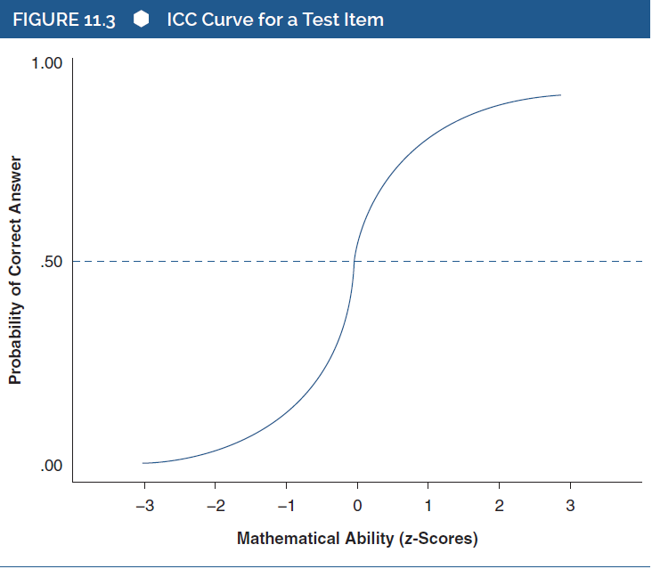
Detecting Construct Bias: Internal Evaluation of a Test (9 of 11)
Differential Item Functioning Analyses
Notes:
Figure 11.3: ICC curve for a test item.

Slide 13
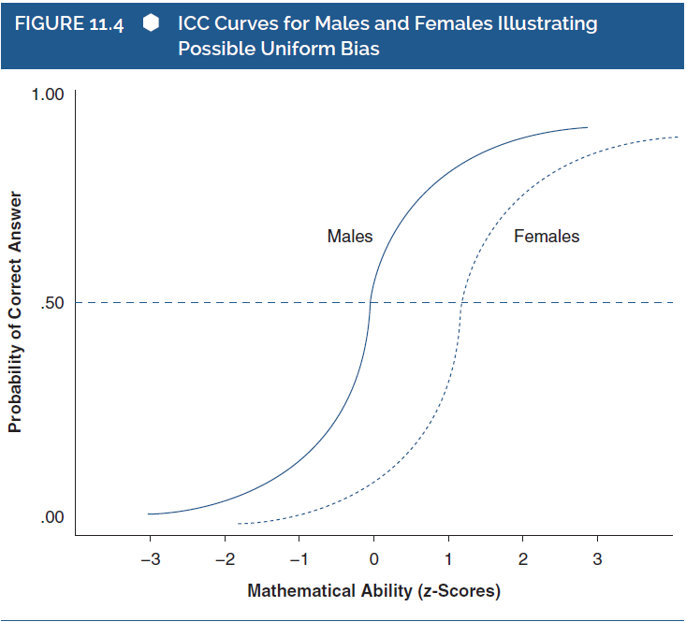
Detecting Construct Bias: Internal Evaluation of a Test (10 of 11)
Differential Item Functioning Analyses
Notes:
Figure 11.4: ICC curves for males and females illustrating possible uniform bias.
Uniform bias: Occurs when two people have the same level of ability but are not equally likely to answer the item correctly.
In this figure, a female is less likely than male with the same math ability to answer the item correctly.
For a male whose math ability is 1 standard deviation above the mean, he has approximately an 80% chance of answering the item correctly.
However, a female who has the same level of math ability has only about a 25% chance of answering correctly.

Slide 14
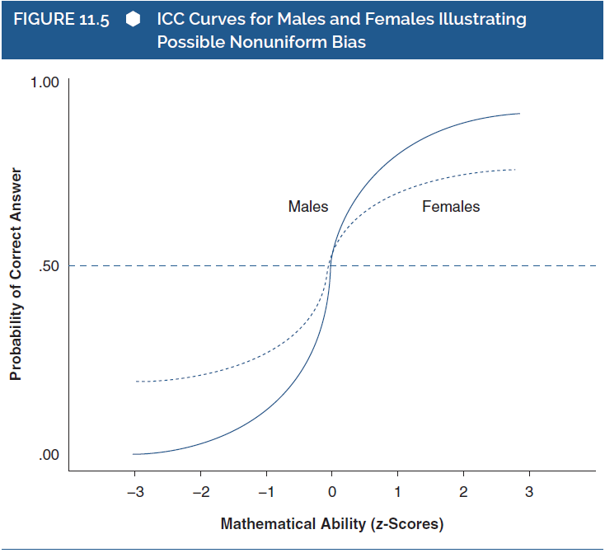
Detecting Construct Bias: Internal Evaluation of a Test (11 of 11)
Differential Item Functioning Analyses
Notes:
Figure 11.5: ICC curves for males and females illustrating possible nonuniform bias.
Nonuniform bias: A situation in which the ICCs differ in shape as well as location.
In this case, at some levels of math ability, females are more likely to answer the item correctly than are males who have the same level of ability.
However, at other levels of ability, females are less likely to answer the item correctly than are males who have the same level of ability.

Slide 15
Detecting Predictive Bias: External Evaluation of a Test (1 of 15)
Degree to which test scores are predictive.
A great concern in applied psychological and educational measurement.
Detection of bias via assumption of one size fits all.
Considerations to evaluate efficacy and predictive bias of a test.
Notes:
Predictive bias:
It concerns the degree to which a test’s scores are equally predictive of an outcome for two groups.
If a test is more predictive for some groups than for others, then it suffers from predictive bias.
A great concern in applied psychological and educational measurement:
Organizations might make important decisions about hiring individuals on the basis of test scores.
Such decisions can have important implications for those individuals’ lives, for the organizations themselves, and for society.
Hence, test users are concerned about the possibility that test scores might be biased for or against some entire groups of people.
For tests used in such applied testing contexts, there is great concern about predictive bias.
Detection of bias via assumption of one size fits all:
Predictive bias is detected by first making the assumption that “one size fits all,” that is, the test is equally predictive for all groups.
This assumption is then formally evaluated by conducting analyses.
If analyses confirm that the test is equally predictive for both groups, then the test does not suffer from predictive bias.
If analyses indicate that predictor test scores are not equally predictive for both groups, then the test might suffer from predictive bias.
Considerations to evaluate efficacy and predictive bias of a test:
Get participants’ scores on the test.
Obtain their scores on the measure of a relevant criterion.
Know each participant’s gender.

Slide 16
Detecting Predictive Bias: External Evaluation of a Test (2 of 15)
Two issues to be examined after getting information.
Regression: a statistical procedure to address the two issues.
Notes:
Two issues to be examined after getting information:
Does the test actually help us predict the relevant criterion?
Does it predict the relevant criterion equally well for various groups of trainees?
Regression: A statistical procedure to address the two issues: This allows us to use the test scores to calculate predicted scores of the relevant criterion.

Slide 17
Detecting Predictive Bias: External Evaluation of a Test (3 of 15)
Basics of Regression Analysis
Assumption: linear relationship between test scores and criterion scores.
Formula for straight line: Ĉ = a + b(T).
Use of software packages.
Evaluating predictive ability of the test.
Notes:
Assumption of regression analysis: There is a linear relationship between test scores and criterion scores.
Formula for straight line:
Ĉ = a + b(T) where:
Ĉ is the predicted training criterion score for an individual training candidate,
a is the intercept,
b is the regression coefficient or slope, and
T is an individual’s aptitude test score.
This formula can be used to predict criterion scores from test scores.
Use of software packages: We can use software packages such as SPSS and SAS to conduct the regression analysis, which produces values of a and b.
Evaluating predictive ability of the test: This is done by taking any individual’s score on the test (T), plugging it into the regression equation, and calculating a predicted score on the criterion (Ĉ) for that individual.

Slide 18
Detecting Predictive Bias: External Evaluation of a Test (4 of 15)
Basics of Regression Analysis
Table 11.1: Data illustrating regression analysis.
Trainee | Aptitude Test Score | Supervisor Rating | Predicted Supervisor Rating
1 | 32 | 75 | 74.59
2 | 40 | 80 | 79.23
3 | 57 | 81 | 89.09
4 | 60 | 98 | 90.83
Notes:
Table 11.1: Data illustrating regression analysis.

Slide 19
Detecting Predictive Bias: External Evaluation of a Test (5 of 15)
Basics of Regression Analysis
FIGURE 11.6 Results of Regression Analysis of the Data in Table 11.1
Coefficientsª
 | Unstandardized Coefficients |  | Standardized Coefficients
Model | B | Std. Error | Beta | t | Sig.
1 (constant) | 56.034 | 16.018 |  | 3.498 | .073
AptTest | .581 | .329 | .781 | 1.766 | .219
ªDependent Variable: Suprating.
Notes:
Figure 11.6: Results of regression analysis of the data in Table 11.1.

Slide 20
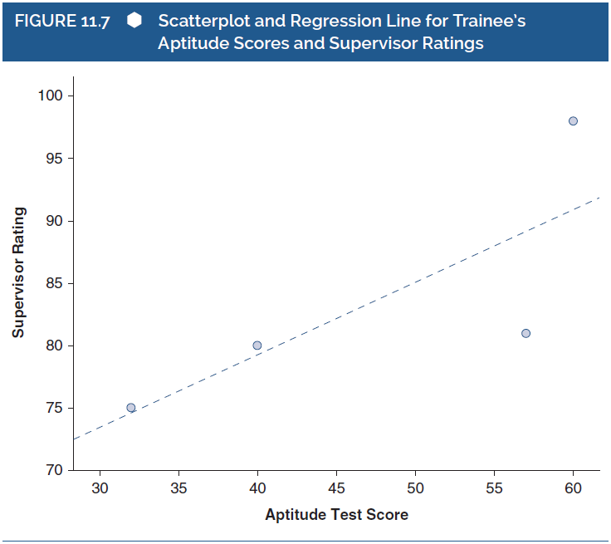
Detecting Predictive Bias: External Evaluation of a Test (6 of 15)
Basics of Regression Analysis
Notes:
Figure 11.7: Scatterplot and regression line for trainee’s aptitude scores and supervisor ratings.

Slide 21
Detecting Predictive Bias: External Evaluation of a Test (7 of 15)
One Size Fits All: The Common Regression Equation
Reflection of predictive ability of test by single regression equation.
Obtaining a common regression equation.
Evaluating the presence of predictive bias.
Ways in which test scores might be biased.
Notes:
One size fits all: The idea that a single regression equation adequately reflects the predictive ability of the test in question.
Obtaining a common regression equation:
This can be done by computing the regression equation based on the data from the entire sample, regardless of psychological attribute.
The values of intercept and slope are common intercept and common slope and they represent the common regression equation.
Evaluating the presence of predictive bias:
This is done by determining whether the common regression equation is equally applicable to all the groups in the sample.
To do this, we need to calculate a separate regression equation for each group.
Then, we must compare each of these group-level regression equations with the common regression equation.
If the group-level equations do not match the common regression equation, then we might conclude that the test scores are predictively biased.
Ways in which test scores might be biased:
When the groups have different intercept values, indicating intercept bias.
When the groups have different slope values, indicating slope bias.
When the groups have both intercept bias and slope bias.

Slide 22
Detecting Predictive Bias: External Evaluation of a Test (8 of 15)
Intercept Bias
Group-level intercept values differ from common intercept.
Implications of the bias:
  Predicted criterion score might be different among groups.
  Test scores might be predictively biased.
Notes:
Intercept bias: Occurs when the group-level intercept values differ from the common intercept.
Implications of the bias: Predicted criterion score might be different among groups:
The fact that the males’ intercept is higher than the females’ intercept indicates that males at any given level of aptitude will receive higher criterion scores than females who have the same level of aptitude.
Example: The predicted criterion score for a male and a female with an aptitude score of 70 are as follows:
Male: 58.03 + .58(70) = 98.63.
Female: 54.03 + .58(70) = 94.63.
From these computations, it is clear that a male and female might have the same test score, but their criterion scores are likely to be different.
Implications of the bias: Test scores might be predictively biased:
If the criterion variable is not biased, then the intercept bias would indicate that the aptitude test does not “work” the same for males and for females.
Given that the common regression equation has the predicted criterion score of 96.63 for a person who had a test score of 70, when comparing these values with the values of group-level predictions, the regression equation appears to underestimate the prediction for males and overestimate the prediction for females.
Thus, one size does not fit all, and the test appears to be predictively biased.

Slide 23

Detecting Predictive Bias: External Evaluation of a Test (9 of 15)
Intercept Bias
Notes:
Figure 11.8: Regression lines for males and females in relation to the common regression line illustrating possible intercept bias.
If a test suffers only from intercept bias, then the size of the group discrepancy is constant across all aptitude scores.
This figure shows that a male trainee of a given aptitude level will obtain a predicted rating that is always 4 points higher than a female who has the same level of aptitude.

Slide 24
Detecting Predictive Bias: External Evaluation of a Test (10 of 15)
Intercept Bias
Use of multiple regression to evaluate intercept bias: Ĉ = a + b₁(T ) + b₂(G).
Role of the slope for group variable, b₂.
Examining whether ACT suffers from sex-based predictive bias.
Complications in detecting intercept bias.
Notes:
Use of multiple regression to evaluate intercept bias:
With this method, we can use more than one variable to predict criterion scores.
When multiple predictors enter a regression analysis, we can determine whether a predictor provides information above and beyond the information provided by the other predictors in the analysis.
A relatively simple version of multiple regression to explore intercept bias is to use only two predictors: The test scores and a dichotomous variable representing group membership.
Example:
When evaluating predictive bias across males and females, the second predictor might be a “group” variable on which all males have a score of 0, whereas all females have a score of 1.
Based on this, researchers might examine the following regression equation: Ĉ = a + b₁(T) + b₂(G).
Role of the slope for group variable, b₂:
It reflects the difference in criterion scores that would be predicted for two people who have the same test scores but who are in different groups.
If it is significantly above or below zero, then the test is likely to suffer from intercept bias.
Examining whether ACT suffers from sex-based predictive bias:
A group of researchers used multiple regression approach to do this examination while predicting college performance.
ACT: A test covering various areas of high school education; scores are often used in the college admissions process.
The researchers ran a multiple regression analysis using the respective equation: Course Grade = a + b₁ (ACT) + b₂ (sex).
Their analyses revealed evidence of bias since the slope for sex was statistically significant.
Complications in detecting intercept bias:
Multiple regression approach is accurate only if there is no slope bias; hence, it is preferred to examine both intercept and slope biases together in a single regression equation.
There is a possibility for the regression to inaccurately suggest the presence of intercept bias due to factors such as imperfect reliability of test, restricted range of test scores, and different average scores of the relevant groups on the test itself.
There may be alternative reasons such as the criterion is biased, for obtaining a significant nonzero b₂, even if the test is unbiased.

Slide 25
Detecting Predictive Bias: External Evaluation of a Test (11 of 15)
Slope Bias
Groups’ slopes differ from common slope.
Degree of discrepancy between criterion scores.
Moderate multiple regression analysis: Ĉ = a + b₁(T) + b₂(G) + b₃(T × G).
Complications in detecting slope bias.
Notes:
Slope bias: Occurs when group-level slope values (b) differ from the common slope.
Implication: Degree of discrepancy between groups’ predicted criterion scores:
The fact that the two groups have different slopes indicates that the amount of bias is not the same across aptitude levels.
Example:
The predicted criterion score for a male and female with a test score of 70 are calculated as follows: male: 56.03 +.53(70) = 93.13; female: 56.03 +.63(70) = 100.13.
From these computations, it is clear that for a male and a female with a test score of 70, the female will be predicted to have a criterion score that is 7.0 points higher than the male’s.
The predicted criterion score for a male and a female with a test score of 60 are calculated as follows: male: 56.03 + .53(60) = 87.83; female: 56.03 + .63(60) = 93.83.
These computations show that the female will be predicted to have a criterion score that is only 6.0 points higher than the male’s.
Thus, we conclude that the discrepancy between male and female criterion scores will tend to increase as scores on the aptitude test increase.
Moderate multiple regression analysis:
This method is used to examine the possibility that group membership “moderates” (or changes) the connection between predictor (test) scores and criterion scores.
If two (or more) groups have different degrees of connection between test and criterion scores, then group membership moderates that connection.
This analysis allows researchers to evaluate both intercept and slope bias at the same time.
It can be conducted using the following equation: Ĉ = a + b₁(T) + b₂(G) + b₃(T × G).
Here, the b₃ slope represents the difference between the b₁ slopes within each of the two groups.
If this slope is significantly above or below zero, then the test is likely to suffer from slope bias.
The b₂ reflects the degree of intercept bias between the two groups.
If this is not zero, then the test is likely to suffer from slope bias.
Complications in detecting slope bias: In most studies of slope bias, the test has imperfect reliability, the test scores have restricted range in the samples being examined, and the relevant groups have different sizes.

Slide 26

Detecting Predictive Bias: External Evaluation of a Test (12 of 15)
Slope Bias
Notes:
Figure 11.9: Regression lines for males and females in relation to the common regression line illustrating possible slope bias.

Slide 27

Detecting Predictive Bias: External Evaluation of a Test (13 of 15)
Intercept and Slope Bias
Notes:
Figure 11.10: Regression lines for males and females in relation to the common regression line illustrating possible slope and intercept bias.
Intercept and slope bias: Occurs when there is a complex relationship between the test scores and the outcome scores for the different groups.

Slide 28
Detecting Predictive Bias: External Evaluation of a Test (14 of 15)
Criterion Score Bias
Bias of the scores on criterion variable.
Consequence of the bias: complication in detecting test bias.
Notes:
Criterion score bias: Occurs when the scores on the criterion variable are biased.
Consequence of the bias: If the scores on the criterion variable is biased in favor of one group over another, then it would complicate our ability to detect bias accurately in the test itself.

Slide 29
Detecting Predictive Bias: External Evaluation of a Test (15 of 15)
The Effect of Reliability
Slope and intercept are sensitive to test score reliability.
Drop in reliability affects predictive bias.
Notes:
Both the regression slope and the intercept are sensitive to test score reliability.
Drop in reliability affect predictive bias:
With predictive bias, high predictor test and criterion test score reliabilities have been assumed.
A drop in test score reliability can have a profound effect on these parameters and thereby affect predictive bias.

Slide 30
Other Statistical Procedures
Structural equation modeling: yields data related to construct and predict biases.
Complex regression procedures.
Notes:
Structural equation modeling: a statistical procedure that can yield data related to both construct bias and predictive bias, under certain situations.
Complex regression procedures:
These include structural equation modeling and hierarchical regression.
These procedures help us test specific hypotheses about the sources of predictive bias.

Slide 31
Test Fairness
Distinguishing between test bias and test fairness.
Important issue in psychological testing.
Psychometric properties of tests must be one factor.
Notes:
Distinguishing between test bias and test fairness:
Test bias:
A psychometric concept embedded in theories of test score validity.
Defined within psychometric theories, and detectable through specific statistical and research methods.
Test fairness:
Not a psychometric property of a test.
Concerns with the appropriate use of test scores.
A social, philosophical, or legal term representing a person’s value judgment.
Test fairness is an important issue in psychological testing:
This is because testing concerns with procedures for selecting, administering, and interpreting test scores in an applied setting.
Individuals who give and use psychological tests are familiar with the psychometric properties of those tests.
What those individuals do with the test scores might influence someone’s judgment concerning the fairness of the test.
Moreover, a test that has strong psychometric properties might be misused to make judgments that are not fair.
Psychometric properties of tests must be one factor:
It is important that the psychometric properties of tests, including information about potential test score biases, are one factor that informs the use of tests in applied settings.
However, people’s beliefs about the fairness of the use of test scores might or might not be influenced by those psychometric properties.

Slide 32
Example: Is the SAT Biased in Terms of Race or Socioeconomic Status? (1 of 4)
Race/Ethnicity
The University of California (UC) report.
Examination in terms of five groups.
Differences in average SAT scores.
Use of regression to examine predictive bias: GPA = a + b(SAT).
Notes:
The University of California (UC) report:
It was based on nearly 80,000 students who entered eight campuses of the UC system over a 4-year period in the mid- to late 1990s.
It covers many psychometric and practical issues, including the SAT’s potential predictive bias in terms of race/ethnicity and socioeconomic status.
The University of California (UC) report examined the race/ethnicity in terms of five groups: African Americans, Native Americans, Asian Americans, Chicanos/Latinos, and Whites.
Differences in average SAT scores:
The UC report presented average SAT scores for each group, revealing potentially significant differences.
Example: Two groups had average SAT scores greater than 1200, and two groups had averages less than 1100.
Such differences cause concerns about the nature and/or use of the SAT.
Use of regression to examine predictive bias:
Researchers computed the predictive validity of the SAT in terms of its ability to predict college freshman GPA.
They presented “variance-explained” values for each race/ethnicity, which reflect the degree to which variability in one variable is predictable from variability in another variable.
This means for each race/ethnicity, they conducted a regression analysis with GPA as the outcome and SAT scores as the predictor: GPA = a + b(SAT).
Each such analysis produced a variance-explained value.

Slide 33
Example: Is the SAT Biased in Terms of Race or Socioeconomic Status? (2 of 4)
Race/Ethnicity
Table 11.3: Summary of SAT scores and high-school GPA as predictors of college GPA in Geiser and Studley’s (2001) report of the University of California.
 |  | Predictor
Race/ Ethnicity | SAT |  | HSGPA
 | Variance explained (%) | Correlation | Variance explained (%) | Correlation
African American | 10.0 | .32 | 9.5 | .31
Native American | 8.5 | .29 | 8.8 | .30
Asian American | 12.6 | .35 | 15.9 | .40
Chicano/Latino | 10.9 | .33 | 12.0 | .35
White | 10.1 | .32 | 15.6 | .39
Notes:
Table 11.3: Summary of SAT scores and high-school GPA as predictors of college GPA in Geiser and Studley’s (2001) report of the University of California.
Note: HSGPA = high-school grade-point average.
By looking at the values in the table, it might seem that on one hand, there are differences in the values, which might suggest the presence of bias.
On the other hand, it might seem that it’s not clear that these differences are large enough to warrant substantial concern.
To gauge the magnitude of the differences in the table, the differences in the SAT’s predictive power are compared with differences in that of high-school GPA (HSGPA).
According to these findings, there seem to be bigger racial/ethnic disparities in the predictive power of HSGPA than in the SAT.
This fact seems to have been ignored by those who criticize the SAT and promote the HSGPA.
Hence, these results do not provide clear evidence of predictive bias for the SAT in terms of race/ethnicity.

Slide 34
Example: Is the SAT Biased in Terms of Race or Socioeconomic Status? (3 of 4)
Socioeconomic Status
Examination of two pieces of information.
Examining predictive power of SAT by controlling for two SES variables.
Analysis provided by the official report.
Examining equation with SAT and SAT-II.
Notes:
Examination of two pieces of information:
To examine the potential biases related to socioeconomic status (SES), the researchers examined two pieces of information: family income and parents’ educational status.
Higher levels of family income and parental education were interpreted as indicators of high SES.
Examining predictive power of SAT by controlling for two SES variables:
The researchers conducted a multiple regression analysis in which college GPA was the criterion and SAT scores, family income, and parental education are predictors.
Initial analyses revealed that, across all students, the SAT’s correlation with college GPA was .36.
However, when examining the following regression equation, there was essentially no evidence of a compromised predictive power: College GPA = a + b (SAT) + b (family income) + b (parental education).
That is, when “controlling for” only the two SES variables, the predictive power of the SAT changed only slightly from its simple correlation of .36.
Analysis provided by the official report:
The official report provided a different analysis that does not offer clear insight into the possibility that SES compromises the SAT’s predictive power.
It presents the result of a regression equation that included SAT and the two SES variables as predictors of college GPA, along with HSGPA and SAT-II as two additional predictors.
Thus, it was of the form: College GPA = a + b (SAT) + b (family income) + b (parental education) + b (HSGPA) + b (SAT-II).
The results of this equation show that the SAT’s predictive power is dramatically reduced thereby leading some critics to conclude that the SAT is compromised by its link with SES.
Examining equation with SAT and SAT-II:
The following regression equation was examined in which SAT and SAT-II are the only two predictors: College GPA = a + b (SAT) + b (SAT-II).
The results show that controlling for the SAT-II alone severely reduces the predictive power of the SAT.
Controlling for additional variables has relatively modest effects on the predictive power of the SAT beyond that.
Thus, the small predictive value of the SAT in previous equation is due to its overlap with SAT-II rather than to any links to SES.

Slide 35
Example: Is the SAT Biased in Terms of Race or Socioeconomic Status? (4 of 4)
Socioeconomic Status
Table 11.4: Regression results (standardized regression coefficients) for three analyses linking SAT scores to college GPA.
Predictors | Equation 1 | Equation 2 | Equation 3
SAT | .345 | .02 | .10
Family income | .01 | .03
Parental education | .04 | .06
HSGPA |  | .28
SAT-II |  | .24 | .32
Notes:
Table 11.4: Regression results (standardized regression coefficients) for three analyses linking SAT scores to college GPA.
Note: HSGPA = High-school-grade point average.

